Slide 1


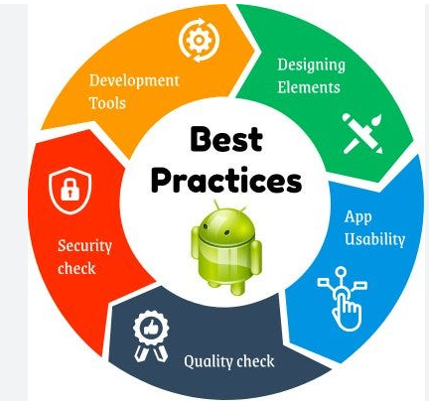

Android Programming

Slide 2
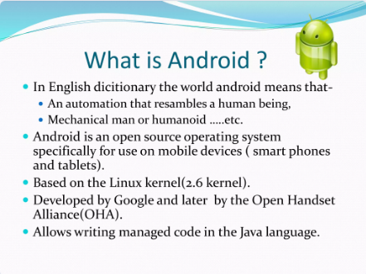
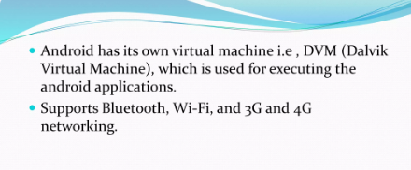

Slide 3
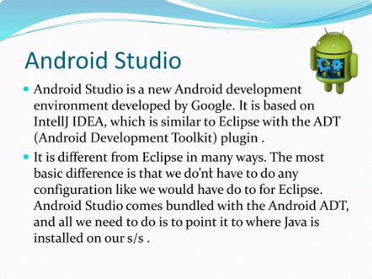

Slide 4
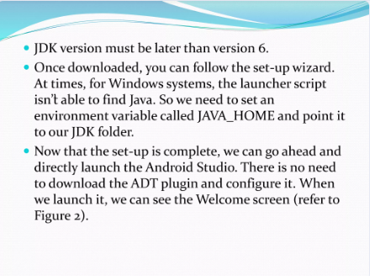

Slide 5
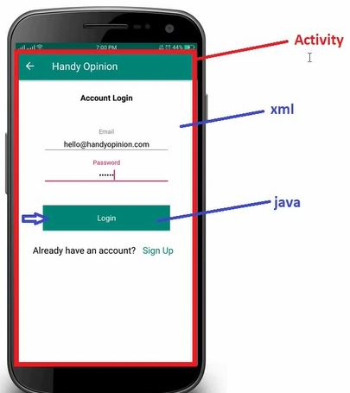
Android Framework
The Android framework is a software framework that provides developers with the tools and resources they need to create Android applications. It's an essential part of the Android operating system and provides a set of pre-built components and APIs that make it easier to develop apps for Android devices.
Android Activity
If you have worked with C, C++ or Java programming language then you must have seen that your program starts from main() function. Very similar way, Android system initiates its program within an Activity starting with a call on onCreate() callback method.
There is a sequence of callback methods that start up an activity and a sequence of callback methods that tear down an activity as shown an activity as shown in the below Activity life cycle diagram.

Slide 6

Activity Launched
onCreate()
User Navigates to the activity
onStart()
onRestart()
onResume()
App Process killed
Activity Running
Another with higher priority need memory
Another Activity comes into the foreground
User Return to the activity
onPause()
User Navigates to the activity
The Activity is no longer visible
onStop()
The Activity is finishing or being destroyed by the system
onDestroy()
Activity Shutdown

Slide 7
The Activity class defines the following call backs i.e. events. You don't need to implement all the callbacks methods. However, it's important that you understand each one and implement those that ensure your app behaves the way users expect.
onCreate()
This is the first callback and called when the activity is first created.
onStart()
This callback is called when the activity becomes visible to the user
onResume()
This is called when the user starts interacting with the application
onPause()
The paused activity does not receive user input and cannot execute any code and called when the current activity is being paused and the previous activity is being resumed.
onStop()
This callback is called when the activity is no longer visible.
onDestroy()
This callback is called before the activity is destroyed by the system
onRestart()
This callback is called when the activity restarts after stopping it.

Slide 8
Android Services
A service is a component that runs in the background to perform long-running operations without needing to interact with the user and it works even if application is destroyed. A service can essentially take two states.
S.No | State & Description
1
2
Started
A service is started when an application component, such as an activity, starts it by calling startService (). Once started, a service can run in the background indefinitely, even if the component that started it is destroyed.
Bound
A service is bound when an application component binds to it by calling bindService(). A bound service offers a client-server interface that allows components to interact with the service, send requests, get results, and even do so across processes with inter process communication (IPC).

Slide 9
Android Services
A service has life cycle callback methods that you can implement to monitor changes in the service's state and you can perform work at the appropriate stage. The following diagram on the left shows the life cycle when the service is created with startService() and the diagram on the right shows the life cycle when the service is created with bindService():

Slide 10
Service is started by startService()
Service is started by bindService()
onCreate()
onCreate()
onBind()
onStart()
Clients interact with the service
Service is running
onRebind()
onunbind()
The Service is stopped(No rollback)
onDestroy()
onDestroy()
Service is shutdown
Service is shutdown

Slide 11
Android Services
To create a service, you create a Java class that extends the Service base class or one of its existing subclasses. The Service base class defines various callback methods and the most important are given below. You don't need to implement all the callbacks methods. However, it's important that you understand each one and implement those that ensure your app behaves the way users expect.
S.No | Callback & Description
1
2
onStartCommand()
The system calls this method when another component, such as an activity, requests that the service be started, by calling startService(). If you implement this method, it is your responsibility to stop the service when its work is done, by calling stopSelf() or stopService() methods.
onBind()
The system calls this method when another component wants to bind with the service by calling bindService(). If you implement this method, you must provide an interface that clients use to communicate with the service, by returning an IBinder object. You must always implement this method, but if you don't want to allow binding, then you should return null.

Slide 12
Android Services
S.No | Callback & Description
3
4
5
6
onUnbind()
The system calls this method when all clients have disconnected from a particular interface published by the service.
onRebind()
The system calls this method when new clients have connected to the service, after it had previously been notified that all had disconnected in its onUnbind(Intent).
onCreate()
The system calls this method when the service is first created using onStartCommand() or onBind(). This call is required to perform one-time set-up.
onDestroy()
The system calls this method when the service is no longer used and is being destroyed. Your service should implement this to clean up any resources such as threads, registered listeners, receivers, etc.

Slide 13
The following skeleton service demonstrates each of the life cycle method
package com.testapp;
import android.app.Service;
import android.os.IBinder;
import android.content.Intent;
import android.os.Bundle;
public class HelloService extends Service {
/** indicates how to behave if the service is killed */
int mStartMode;
/** interface for clients that bind */
IBinder mBinder;
/** Called when the service is being created. */
@Override
public void onCreate() {
}
/** The service is starting, due to a call to startService() */
@Override
public int onStartCommand(Intent intent, int flags, int startId) {
return mStartMode;
}

Slide 14
The following skeleton service demonstrates each of the life cycle method
/** A client is binding to the service with bindService() */
@Override
public IBinder onBind(Intent intent) {
return mBinder;
}
/** Called when all clients have unbound with unbindService() */
@Override
public boolean onUnbind(Intent intent) {
return mAllowRebind;
}
/** Called when a client is binding to the service with bindService()*/
@Override
public void onRebind(Intent intent) {
}
/** Called when The service is no longer used and is being destroyed */
@Override
public void onDestroy() {
}
}

Slide 15
Android-Broadcast Receivers
Broadcast Receivers simply respond to broadcast messages from other applications or from the system itself. These messages are sometime called events or intents.
For example, applications can also initiate broadcasts to let other applications know that some data has been downloaded to the device and is available for them to use, so this is broadcast receiver who will intercept this communication and will initiate appropriate action.
There are following two important steps to make Broadcast Receiver works for the system broadcasted intents .
Creating the Broadcast Receiver.
Registering Broadcast Receiver.
There is one additional steps in case you are going to implement your custom intents then you will have to create and broadcast those intents.

Slide 16
Creating the Broadcast Receiver
A broadcast receiver is implemented as a subclass of BroadcastReceiver class and overriding the onReceive() method where each message is received as a Intent object parameter
public class MyReceiver extends BroadcastReceiver {
@Override
public void onReceive(Context context, Intent intent) {
Toast.makeText(context, "Intent Detected.", Toast.LENGTH_LONG).show();
}
}
Registering Broadcast Receiver
An application listens for specific broadcast intents by registering a broadcast receiver in AndroidManifest.xml file. Consider we are going to register MyReceiver for system generated event ACTION_BOOT_COMPLETED which is fired by the system once the Android system has completed the boot process.

Slide 17
Registers for intents to observe
Android System
Broadcast Receiver
Get Notifications when intents occurs
<application
android:icon="@drawable/ic_launcher"
android:label="@string/app_name"
android:theme="@style/AppTheme" >
<receiver android:name="MyReceiver">
<intent-filter>
<action android:name="android.intent.action.BOOT_COMPLETED">
</action>
</intent-filter>
</receiver>
Now whenever your Android device gets booted, it will be intercepted by BroadcastReceiver MyReceiver and implemented logic inside onReceive() will be executed.
</application>

Slide 18
There are several system generated events defined as final static fields in the Intent class. The following table lists a few important system events.
S.No | Event Constant & Description
1
2
3
4
5
6
7
android.intent.action.BATTERY_CHANGED
Sticky broadcast containing the charging state, level, and other information about the battery.
android.intent.action.BATTERY_LOW
Indicates low battery condition on the device
android.intent.action.BATTERY_OKAY
Indicates the battery is now okay after being low.
android.intent.action.BOOT_COMPLETED
This is broadcast once, after the system has finished booting.
android.intent.action.BUG_REPORT
Show activity for reporting a bug.
android.intent.action.CALL
Perform a call to someone specified by the data
android.intent.action.CALL_BUTTON
The user pressed the "call" button to go to the dialer or other appropriate UI for placing a call.

Slide 19
S.No | Event Constant & Description
8
9
android.intent.action.DATE_CHANGED
The date has changed.
android.intent.action.REBOOT
Have the device reboot
Broadcasting Custom Intents
If you want your application itself should generate and send custom intents then you will have to create and send those intents by using the sendBroadcast() method inside your activity class. If you use the sendStickyBroadcast(Intent) method, the Intent is sticky, meaning the Intent you are sending stays around after the broadcast is complete.
public void broadcastIntent(View view) {
Intent intent = new Intent();
intent.setAction("com.androidapp.CUSTOM_INTENT");
sendBroadcast(intent);
}

Slide 20
This intent com.androidapp.CUSTOM_INTENT can also be registered in similar way as we have registered system generated intent.
<application
android:icon="@drawable/ic_launcher"
android:label="@string/app_name"
android:theme="@style/AppTheme" >
<receiver android:name="MyReceiver">
<intent-filter>
<action android:name="com.androidapp.CUSTOM_INTENT">
</action>
</intent-filter>
</receiver>
</application>

Slide 21
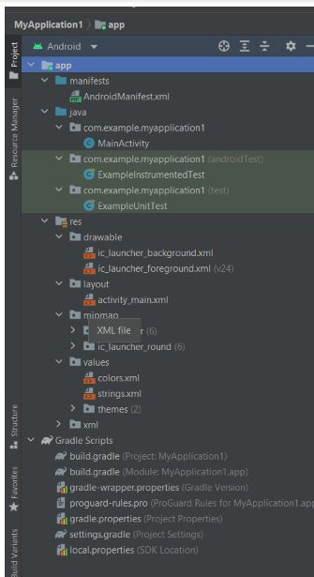
Android Project Folder Structure
Jet Brains community developed Android Studio, the official IDE (Integrated Development Environment) for Android app development and is freely distributed by Google.
After the complete Android Architecture setup, we can construct an Android application in the studio. For each sample application, we should establish a new project and learn the folder structure.
After setting up an Android development environment in Android Studio, we can create an example application, and our project folder structure will look like this.
The structure of the Android project on disk can differ from the above picture. Select Project from the Project selection instead of Android to see the Project's actual file structure.
Many app modules, source code files, and resource files are included in the Android project. We'll go through all of the Android app's directories and files.

Slide 22
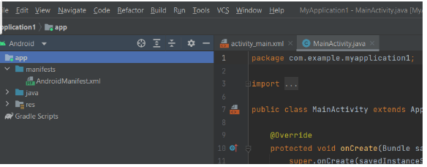
Manifests Folder
This folder includes the AndroidManifest.xml, which we will use to create the Android application. This file holds information about our applications, such as the Android versions, metadata, the states packages for the Java code, and other app components. It functions as a bridge between the Android operating system and our application.
Let's see the manifests folder structure of the Android application shown below.

Slide 23
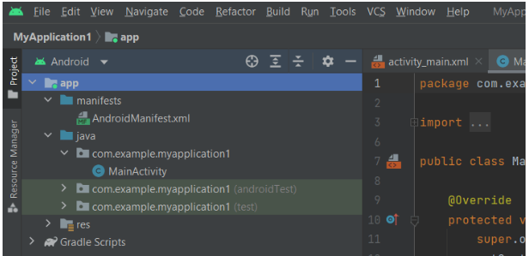
Java Folder
The Java folder holds all of the java and Kotlin source code (.java) files created during app development, as well as additional Test files. When we begin a fresh Java project, the class file MainActivity.java is automatically produced under the package name "com.example.myapplication1" as seen here

Slide 24
What is Java
Java is a multi-platform, object-oriented, and network-centric, programming language. It is among the most used programming language. It also used as a computing platform, and it was first released by Sun Micro system in 1995. It was later acquired by Oracle Corporation.
Difference b/w HTML/XML
HTML and XML are two popular markup languages in application development and web development. Even though they have similar names, they have different use cases. HTML is primarily used to develop an application’s UI. It renders the text, images, buttons, checkboxes, and dropdown boxes seen on a website or application. In contrast, the primary purpose of XML is the exchange and transfer of data. It encodes data in a format readable by both machines and humans. XML describes what the data is, while HTML determines how to display the data to the end user.

Slide 25
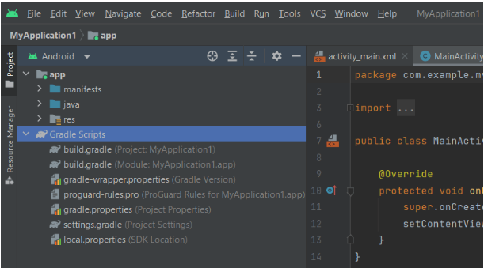
Folder res/midmap
This section includes launcher.xml files that specify the icons on the home screen. It has several icon densities based on the device size, such as hdpi, mdpi, and xhdpi.
Folder res/Values
The Values folder contains various XML files such as strings, dimensions, colors, and style definitions. The strings.xml file, which includes the resources, is one of the most crucial
Gradle Scripts Directory
Gradle is an automated build system that includes several files that create a build configuration. Build scripts are used in the build.gradle (Project), and plugins and implementations are used in the build.gradle (Module) to make settings that may be used by all of our application modules
Gradle is also used to generate .apk file from .java & .XML file

Slide 26
Android-UI Layouts
The basic building block for user interface is a View object which is created from the View class and occupies a rectangular area on the screen and is responsible for drawing and event handling
View is the base class for widgets, which are used to create interactive UI components like buttons, text fields, etc.
The ViewGroup is a subclass of View and provides invisible container that hold other Views or other ViewGroups and define their layout properties.
At third level we have different layouts which are subclasses of ViewGroup class and a typical layout defines the visual structure for an Android user interface and can be created either at run time using View/ViewGroup objects or you can declare your layout using simple XML file main_layout.xml which is located in the res/layout folder of your project.

Slide 27
Important Points
View
View refers to the “android.view.View” class which is the parents class of all the UI classes.
Examples for views are TextView, Button, CheckBox, ImageView etc.
Some child classes of View class are TextView, Button, CheckBox, ImageView etc.
ViewGroup
ViewGroup refers to the “android.view.ViewGroup” which is the parents class for layouts and layouts parameters
Examples for ViewGroup are LinearLayout,RelativeLayout,ConstraintLayout etc.
ViewGroup is the invisible container, which holds the views or view groups
Android Layouts
Layout refers the arrangement of elements i.e. TextView, Button etc on the container
Examples are LinearLayout, RelativeLayout etc.

Slide 28
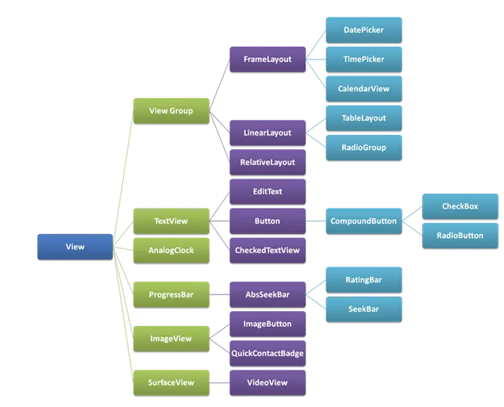

Slide 29
Android Layout Types
There are number of Layouts provided by Android which you will use in almost all the Android applications to provide different view, look and feel.
Sr.No | Layout & Description
1
2
3
4
5
6
7
Linear Layout
Linear Layout is a view group that aligns all children in a single direction, vertically or horizontally.
Relative Layout
Relative Layout is a view group that displays child views in relative positions.
Table Layout
Table Layout is a view that groups views into rows and columns.
Absolute Layout
Absolute Layout enables you to specify the exact location of its children.
Frame Layout
The Frame Layout is a placeholder on screen that you can use to display a single view.
List View
ListView is a view group that displays a list of scrollable items.
Grid View
GridView is a ViewGroup that displays items in a two-dimensional, scrollable grid.

Slide 30
Layout Attributes
Each layout has a set of attributes which define the visual properties of that layout. There are few common attributes among all the layouts and there are other attributes which are specific to that layout. Following are common attributes and will be applied to all the layouts
Sr.No | Attrbute & Description
1
2
3
4
5
6
7
android:id
This is the ID which uniquely identifies the view. positions.
android:layout_width
This is the width of the layout.
android:layout_height
This is the height of the layout
android:layout_marginTop
This is the extra space on the top side of the layout.
android:layout_marginBottom
This is the extra space on the bottom side of the layout.
android:layout_marginLeft
This is the extra space on the left side of the layout.
android:layout_marginRight
This is the extra space on the right side of the layout.

Slide 31
Layout Attributes
Sr.No | Attrbute & Description
8
9
10
11
12
13
14
15
16
android:layout_gravity
This specifies how child Views are positioned.
android:layout_weight
This specifies how much of the extra space in the layout should be allocated to the View
android:layout_x
This specifies the x-coordinate of the layout.
android:layout_y
This specifies the y-coordinate of the layout.
android:layout_width
This is the width of the layout
android:paddingLeft
This is the left padding filled for the layout.
android:paddingRight
This is the right padding filled for the layout.
android:paddingTop
This is the top padding filled for the layout
android:paddingBottom
This is the bottom padding filled for the layout.

Slide 32
Layout Attributes
Here width and height are the dimension of the layout/view which can be specified in terms of dp (Density-independent Pixels), sp ( Scale-independent Pixels), pt ( Points which is 1/72 of an inch), px( Pixels), mm ( Millimeters) and finally in (inches).
You can specify width and height with exact measurements but more often, you will use one of these constants to set the width or height −
android:layout_width=wrap_content
tells your view to size itself to the dimensions required by its content.
android:layout_width=fill_parent
tells your view to become as big as its parent view.
Gravity attribute plays important role in positioning the view object and it can take one or more (separated by '|') of the following constant values.
Constant | Value | Description
Top | 0x30 | Push object to the top of its container, not changing its size.
Bottom | 0x50 | Push object to the bottom of its container, not changing its size.

Slide 33
Layout Attributes
Constant | Value | Description
clip_vertical | 0x80 | Additional option that can be set to have the top and/or bottom edges of the child clipped to its container's bounds. The clip will be based on the vertical gravity: a top gravity will clip the bottom edge, a bottom gravity will clip the top edge, and neither will clip both edges.
clip_horizontal | 0x08 | Additional option that can be set to have the left and/or right edges of the child clipped to its container's bounds. The clip will be based on the horizontal gravity: a left gravity will clip the right edge, a right gravity will clip the left edge, and neither will clip both edges.
Start | 0x00800003 | Push object to the beginning of its container, not changing its size.
End | 0x00800005 | Push object to the end of its container, not changing its size.

Slide 34
Layout Attributes
Constant | Value | Description
Top | 0x30 | Push object to the top of its container, not changing its size.
Bottom | 0x50 | Push object to the bottom of its container, not changing its size.
Left | 0x03 | Push object to the left of its container, not changing its size.
Right | 0x05 | Push object to the right of its container, not changing its size.
center_vertical | 0x10 | Place object in the vertical center of its container, not changing its size.
fill_vertical | 0x70 | Grow the vertical size of the object if needed so it completely fills its container.
center_horizontal | 0x01 | Place object in the horizontal center of its container, not changing its size.
fill_horizontal | 0x07 | Grow the horizontal size of the object if needed so it completely fills its container.
Center | 0x11 | Place the object in the center of its container in both the vertical and horizontal axis, not changing its size
Fill | 0x77 | Grow the horizontal and vertical size of the object if needed so it completely fills its container.

Slide 35
View Identification
A view object may have a unique ID assigned to it which will identify the View uniquely within the tree. The syntax for an ID, inside an XML tag is −
android:id="@+id/my_button”
Following is a brief description of @ and + signs −
The at-symbol (@) at the beginning of the string indicates that the XML parser should parse and expand the rest of the ID string and identify it as an ID resource.
The plus-symbol (+) means that this is a new resource name that must be created and added to our resources. To create an instance of the view object and capture it from the layout, use the following −
Button myButton = (Button) findViewById(R.id.my_button);

Slide 36
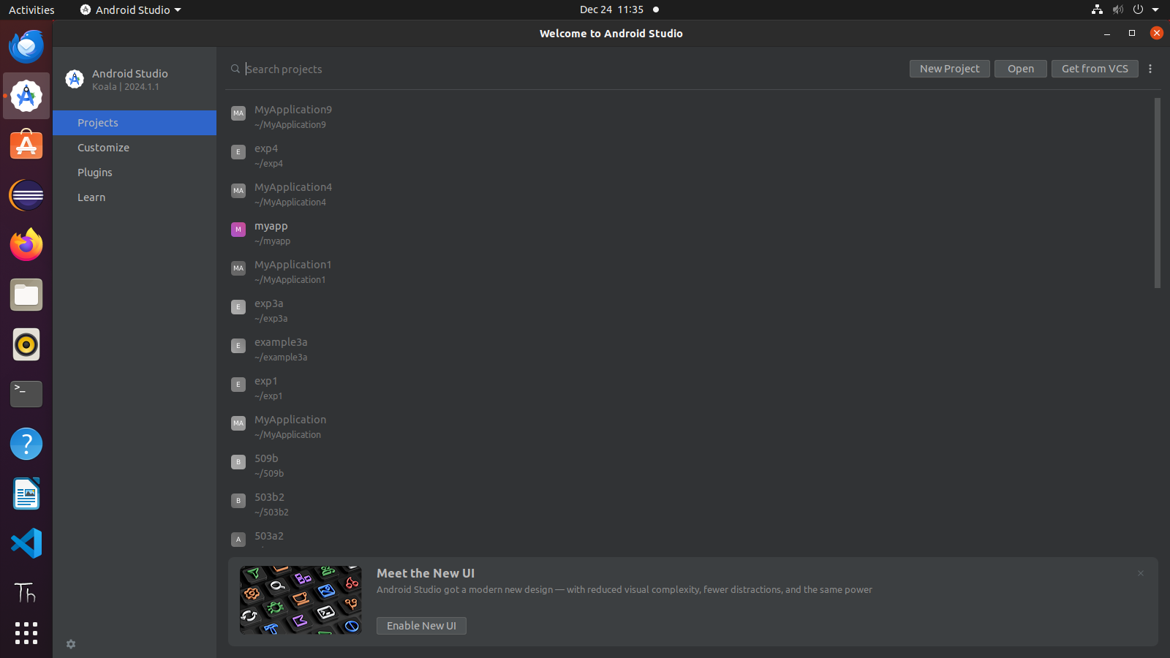

Slide 37
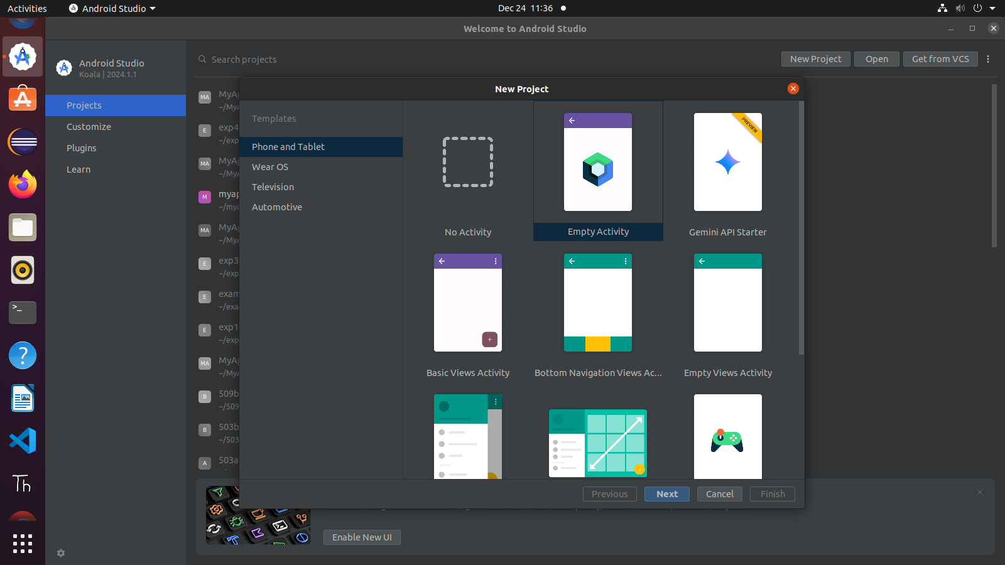

Slide 38
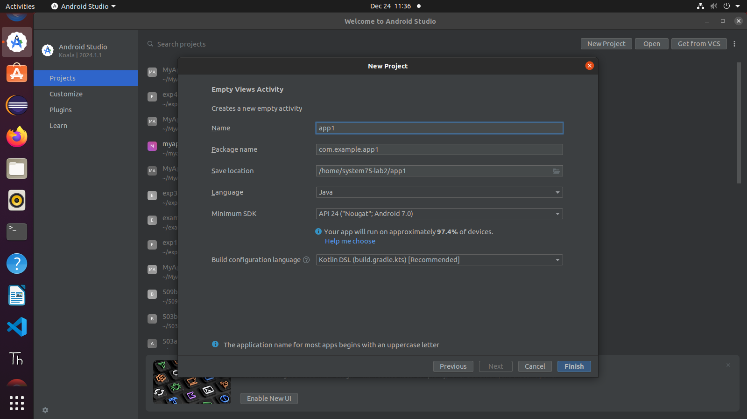

Slide 39
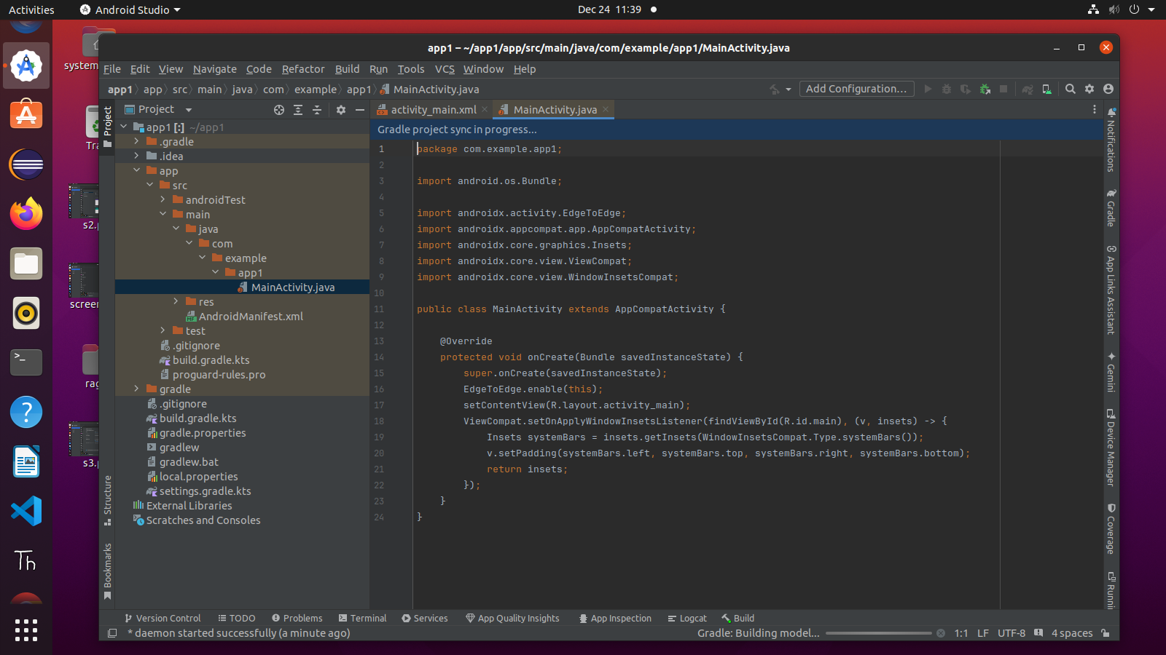

Slide 40
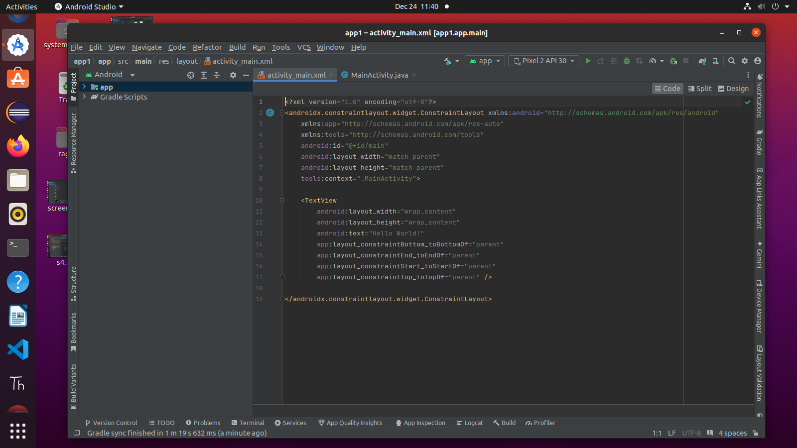

Slide 41
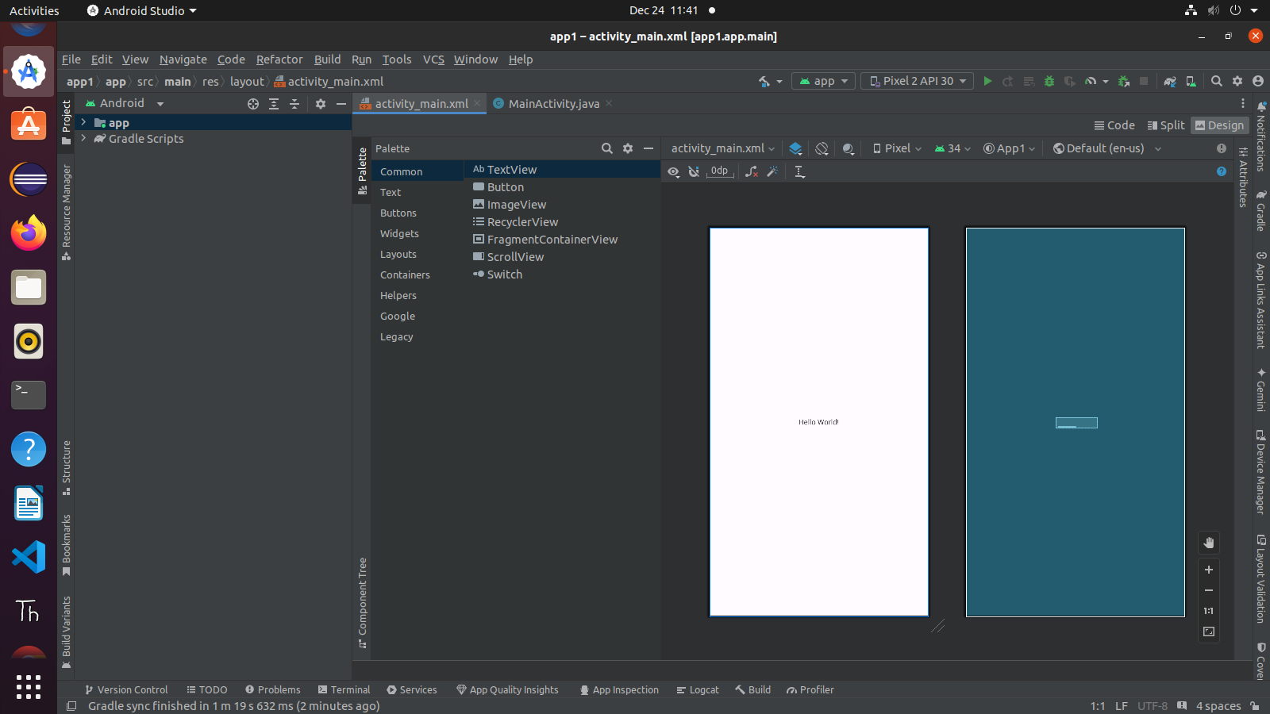

Slide 42


Slide 43
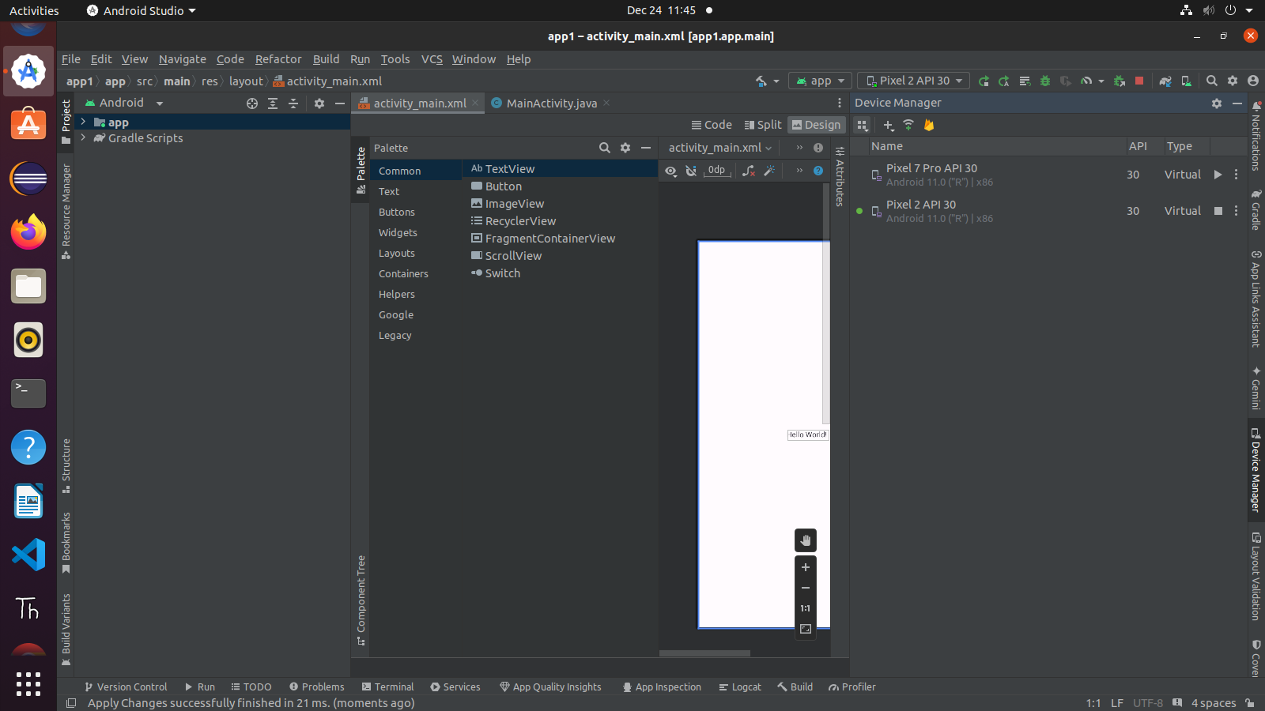

Slide 44
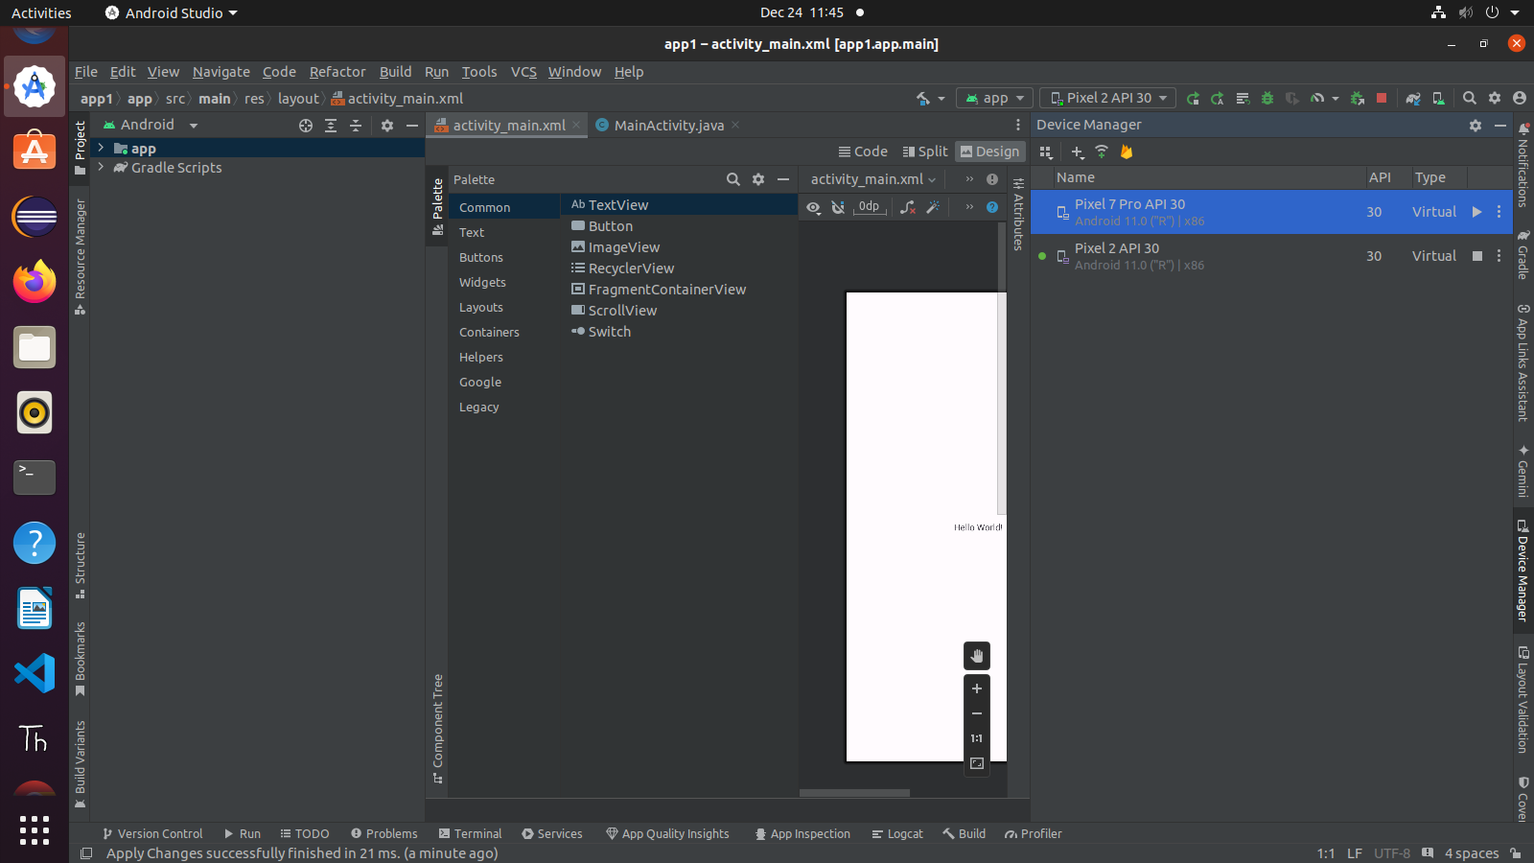

Slide 45
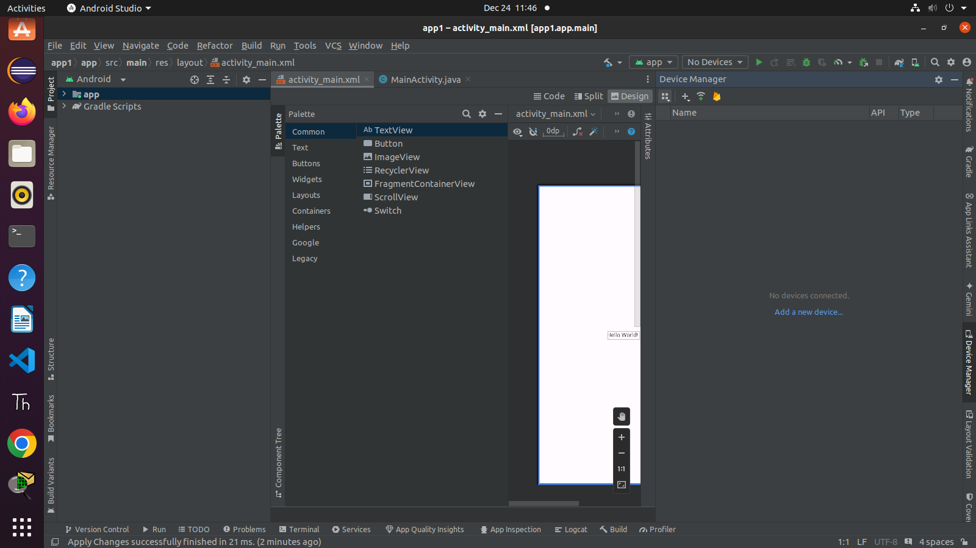

Slide 46
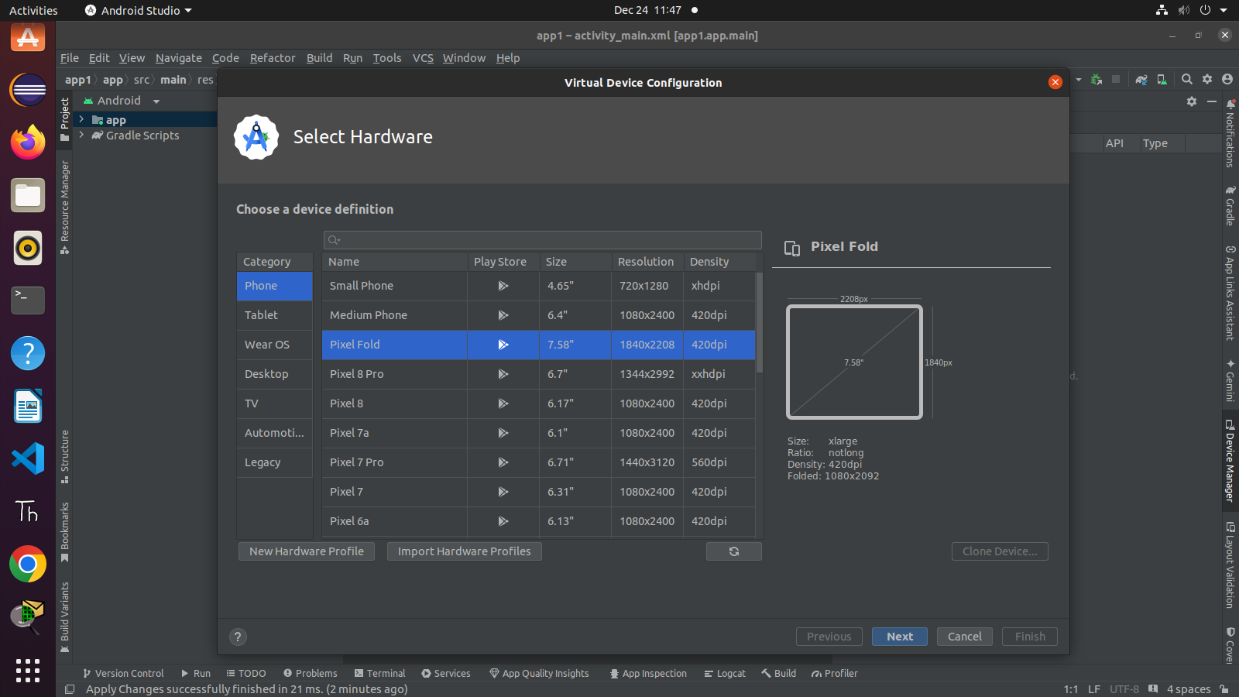

Slide 47
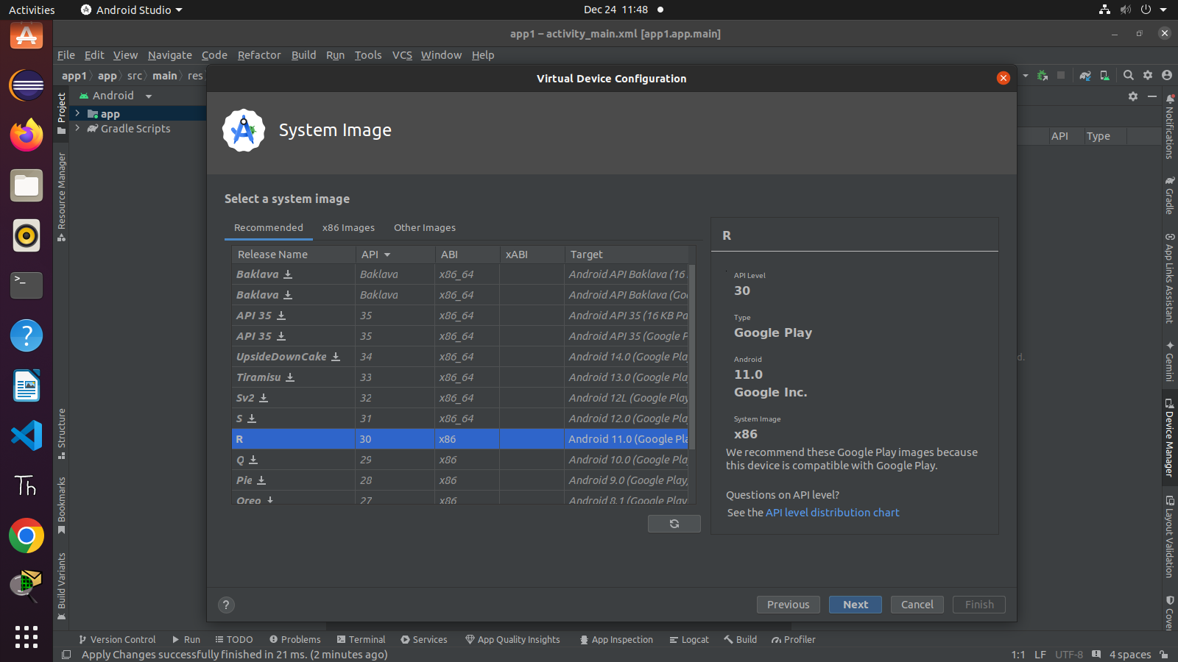

Slide 48
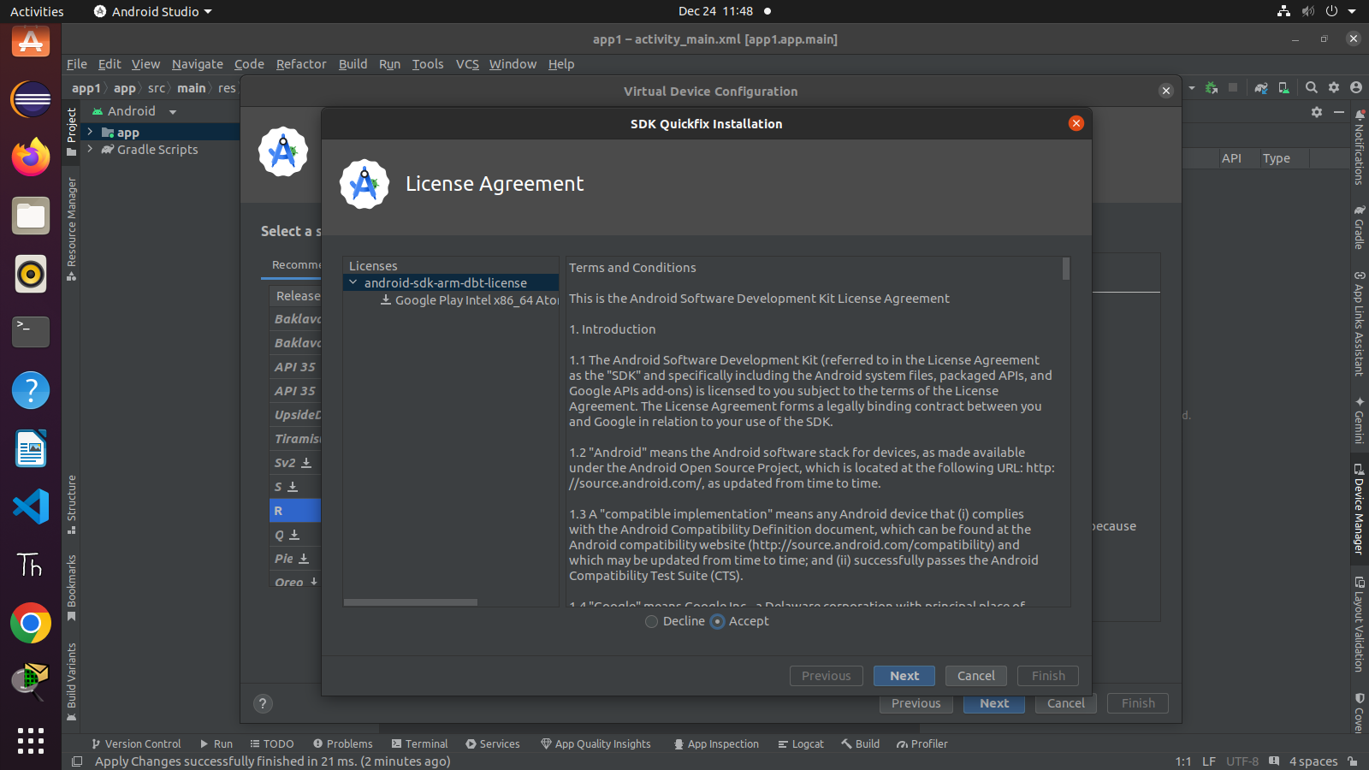

Slide 49
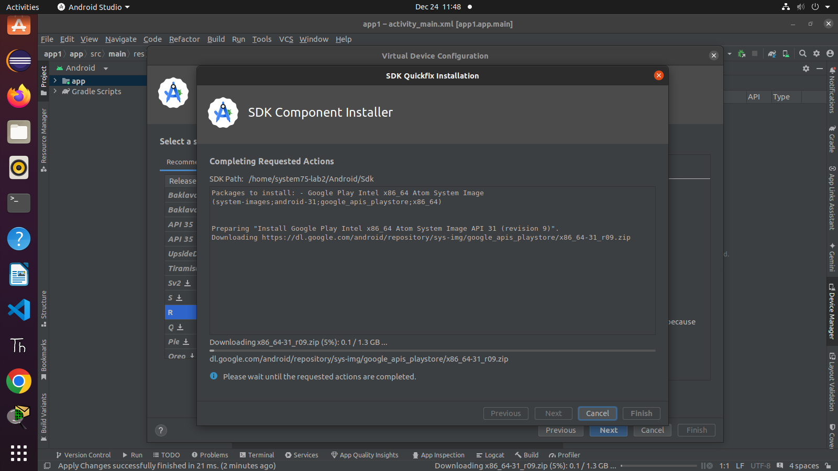

Slide 50
